Slide 1
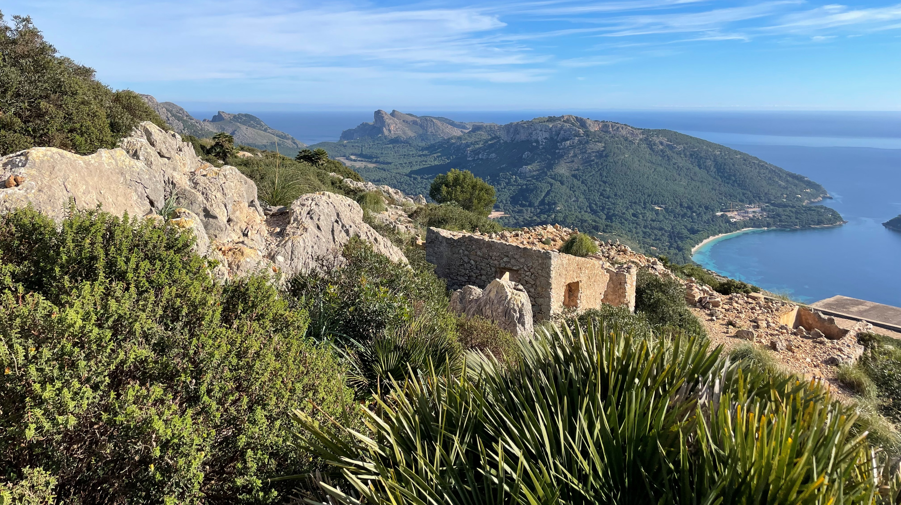
Mediterranean Environments
Remote sensing of burned areas – Laura Turnbull-Lloyd

Slide 2
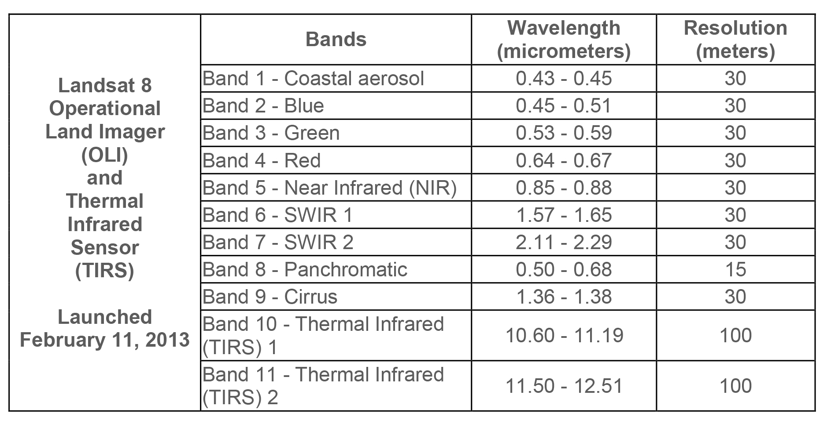
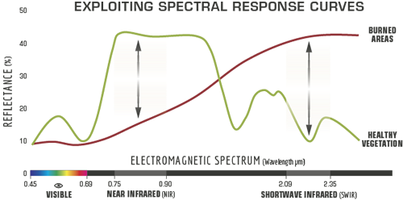
BURN SEVERITY MAPPING USING THE NORMALIZED BURN RATIO (NBR)
The normalized burn ratio uses the near infrared and shortwave infrared wavelengths to emphasize charred areas in an image.
NBR = ([NIR-SWIR2]/[NIR+SWIR2])
The delta normalized burned ratio compares the normalized burn ratios of before and after the fire and is used to analyse the severity of the burn.
dNBR = (NBRpre-fire - NBRpost-fire)
Notes:
Intro to band math
Remote sensing of surface properties often entails using spectral information, in the form of spectral indices, to identify changes in, for example, vegetation cover or water cover. Spectral indices are based on the fact that reflectance spectra of different land covers are different. The indices are designed to exploit these differences to accentuate particular land cover types.
To calculate these indices, such as the NDVI (Normalized Difference Vegetation Index), the NDWI (Normalized Difference Water Index), or the dNBR (delta Normalized Burn Ratio), we need to use the information contained within individual bands of images.

Slide 3
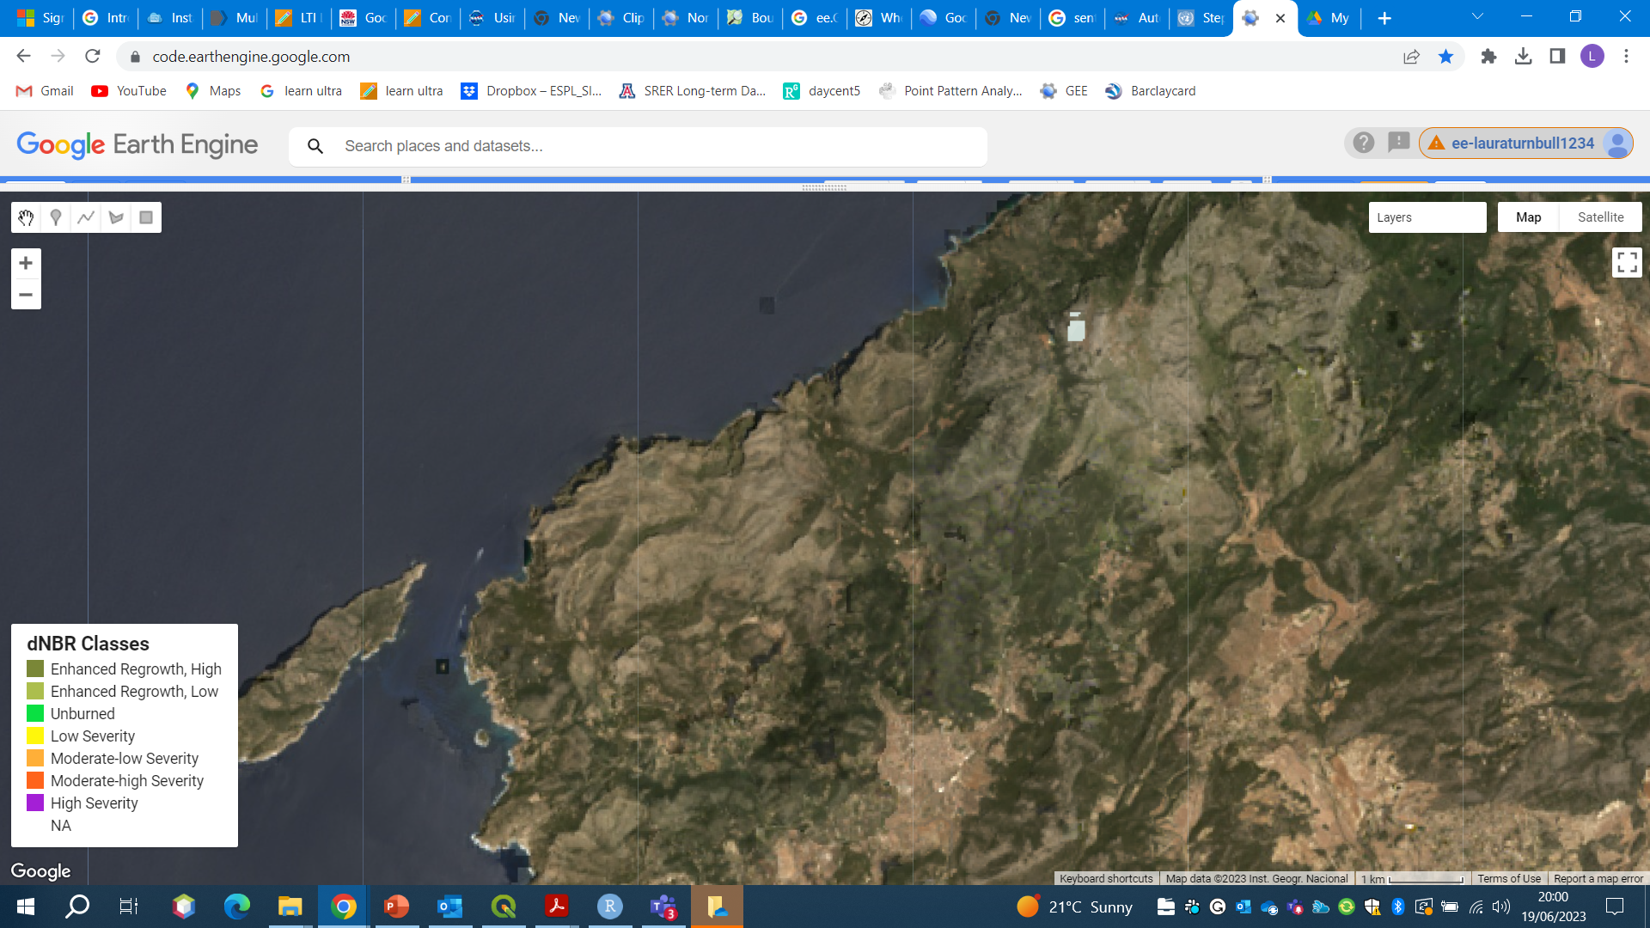
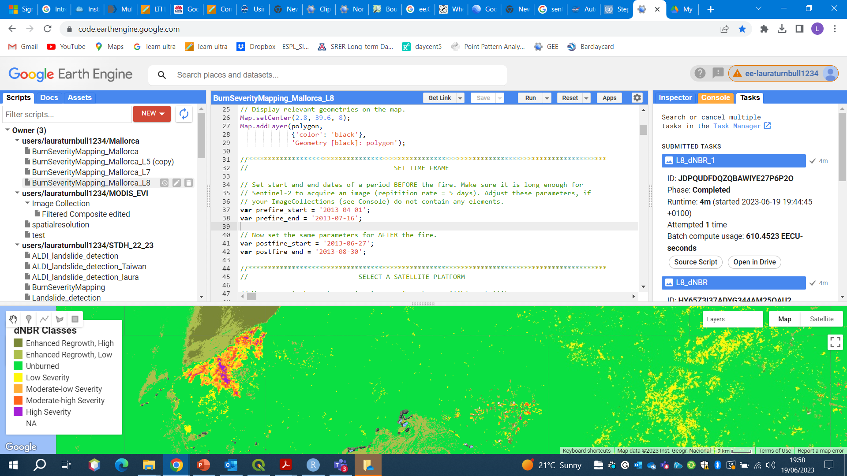
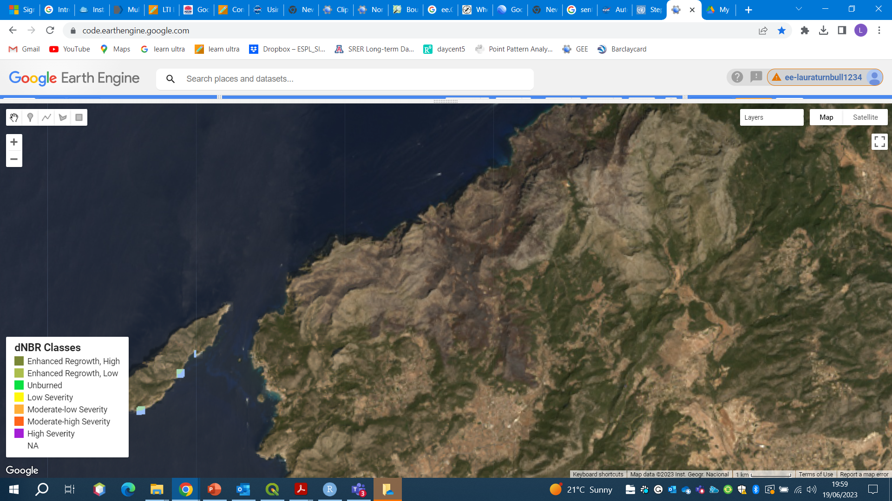
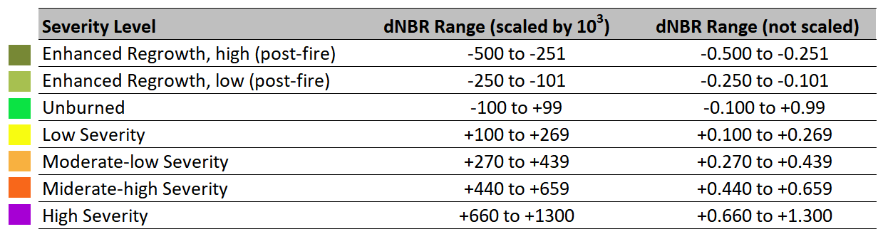

Slide 4
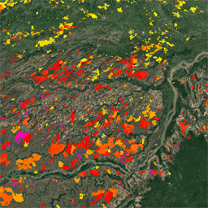
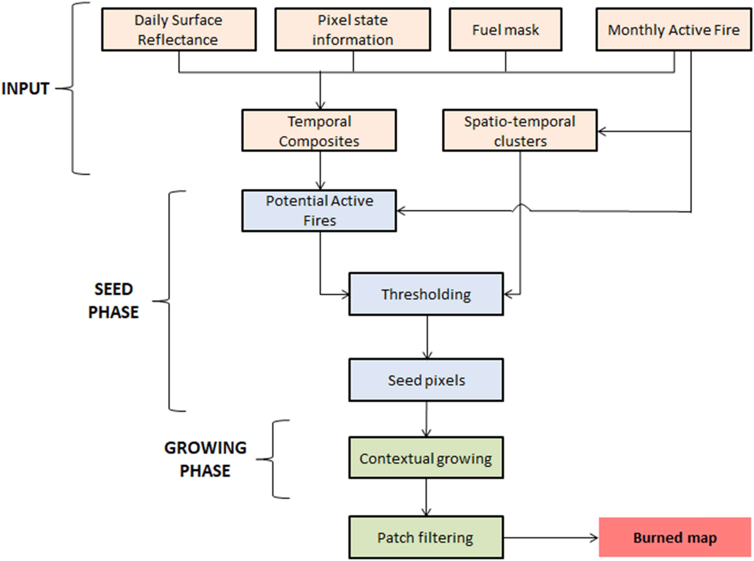
FireCCI51 burned area pixel product, based on MODIS reflectance at 250 m resolution
Lizundia-Loiola et al. (2020) https://doi.org/10.1016/j.rse.2019.111493
2001-2019
Uses thermal anomalies & near-infrared reflectance values
https://developers.google.com/earth-engine/datasets/catalog/ESA_CCI_FireCCI_5_1

Slide 5

Google Earth Engine
Google Earth Engine allows users to run algorithms on georeferenced imagery and vectors stored on Google's infrastructure.
The Google Earth Engine API provides a library of functions which may be applied to data for display and analysis.
Earth Engine's public data catalog contains a large amount of publicly available imagery and vector datasets.
Private assets can also be created in users' personal folders.
There are many Google Earth Engine resources available to you.
Get Started with Earth Engine | Google Earth Engine | Google Developers

Slide 6
